Slide 1

Digitronix

Slide 2
Table of contents

Slide 3
Table of contents
1. Our Team

Slide 4
Table of contents
2. Stages of realization
1. Our Team

Slide 5
Table of contents
2. Stages of realization
1. Our Team
3. Used Tehnologies

Slide 6



Our TEAM
Selin Vatansever
Radoslav Stoyanov
Rafail Kolibarov
Designer
FrontEnd Developer
Scrum Trainer

Slide 7
Our TEAM
Selin Vatansever
Rafail Kolibarov
Radoslav Stoyanov
Scrum Trainer
Designer
FrontEnd Developer

Slide 8
Our TEAM
Selin Vatansever
Rafail Kolibarov
Radoslav Stoyanov
Scrum Trainer
FrontEnd Developer
Designer

Slide 9
Our TEAM
Rafail Kolibarov
Radoslav Stoyanov
Selin Vatansever
Scrum Trainer
FrontEnd Developer
Designer

Slide 10
Stages of realization
We made a simple console-based implementation of the classic Minesweeper game built using C++. The game features random mine placement, cell reveal logic, flagging system, and automatic win/loss detection. This project demonstrates core C++ concepts such as arrays, loops, functions, and basic game logic.

Slide 11
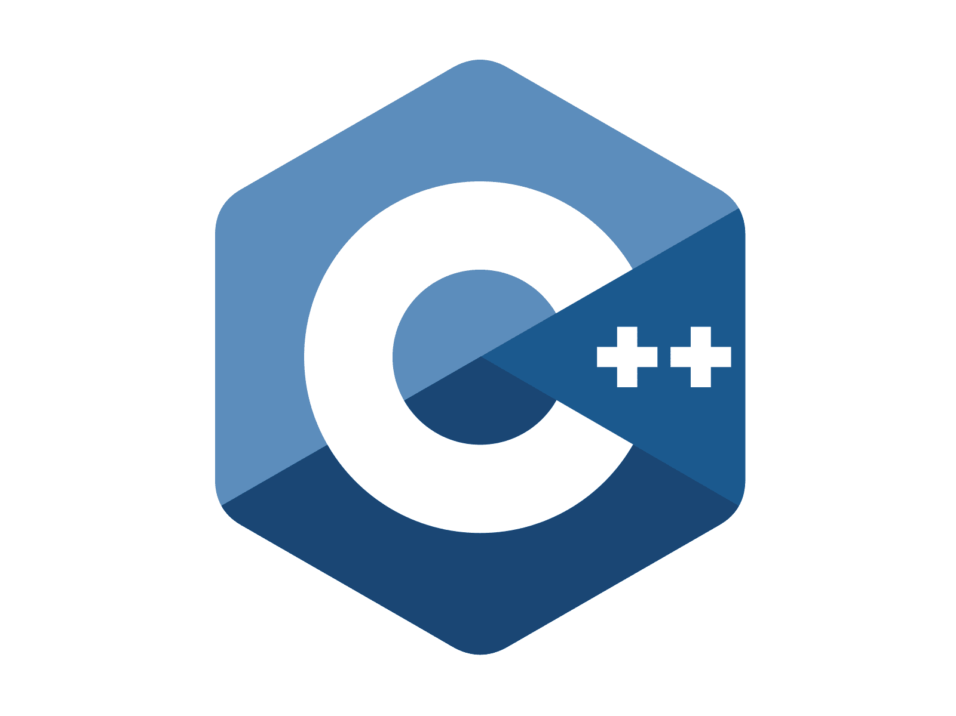








Used tehnologies

Slide 12
Used tehnologies

Slide 13
Used tehnologies

Slide 14
Used tehnologies

Slide 15
Used tehnologies

Slide 16
Lets go !

